Slide 1

Department of Computer Science and Engineering
OBJECT DETECTION AND LOCALIZATION
Date: 27 May 2021
G. VAISHNAVI : 17WH1A0564
NAKHVEEN AHMED : 17WH1A0580
B. ANJANI : 17WH1A0583
Internal Guide: Ms. SUPARNA DAS
Designation : Assistant Professor

Slide 2

Abstract
Why Should I Study this course?
Object detection is a part of every person life.
Blindness, partially or fully makes it difficult for people to detect.
There are some other cases where it is also hard for people with good eyesight to detect images because of the size of objects in the image or video or lack of domain knowledge or lack of time.
These problems can be solved by using a model, YOLO ( You only look once), which is a super fast algorithm, being a standard now, to detect and localize images in an image or a video.
Extending the model, by adding an audio part also makes it useful for people with poor eyesight.
The objects are detected using YOLO model and the objects are spoke out using gtts library in python.
Examples
BVRIT HYDERABAD College of Engineering for Women

Slide 3
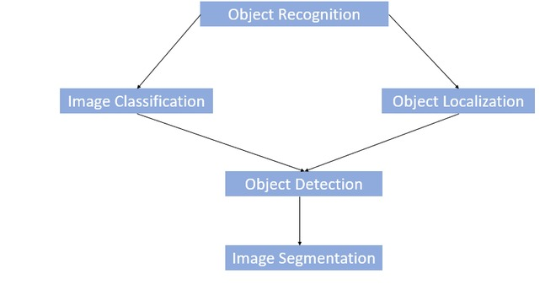
Block Diagram
Why Should I Study this course?
Examples
BVRIT HYDERABAD College of Engineering for Women

Slide 4
SYSTEM SPECIFICATIONS
Why Should I Study this course?
ENVIRONMENT
Examples
SPECIFICATIONS
Processor- Intel Core i3/i5
Memory(RAM)-8GB
Storage- 1 TB
Python/ Matlab
OS- Window 10
Google Collab
Hardware
Software
BVRIT HYDERABAD College of Engineering for Women

Slide 5
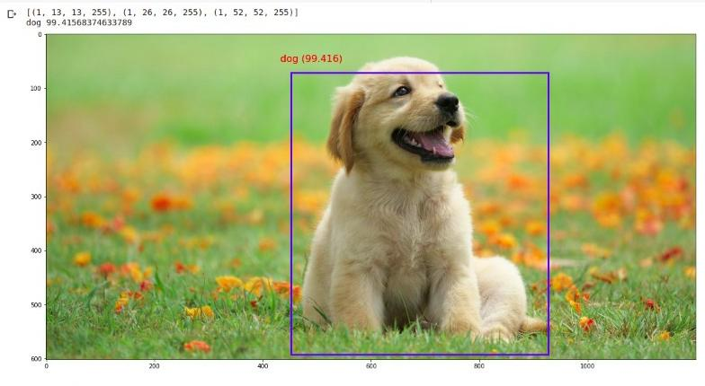
OUTPUT
BVRIT HYDERABAD College of Engineering for Women

Slide 6
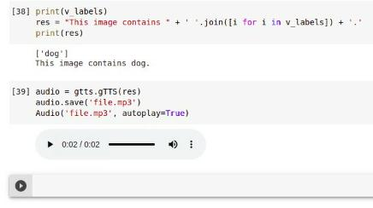
OUTPUT

Slide 7
REFERENCES
M. B. Blaschko and C. H. Lampert. Learning to localize objects with structured output regression. In Computer Vision– ECCV 2008, pages 2–15. Springer, 2008.
S. Gidaris and N. Komodakis. Object detection via a multiregion & semantic segmentation-aware CNN model. CoRR, abs/1505.01749, 2015.
R. Girshick, J. Donahue, T. Darrell, and J. Malik. Rich feature hierarchies for accurate object detection and semantic segmentation. In Computer Vision and Pattern Recognition (CVPR), 2014 IEEE Conference on, pages 580–587. IEEE, 2014.
S. Ren, K. He, R. Girshick, and J. Sun. Faster r-cnn: Towards real-time object detection with region proposal networks. arXiv preprint arXiv:1506.01497, 2015

Slide 8
Thankyou

